Slide 1
Final Project
CS 321-02 Spring 2019

Slide 2
Introduction
Members, Responsibilities, and Workflow
Project Summary
Project Details
UML Diagram
Use Cases
Demo
Q&A

Slide 3
Members
Team Members
Sean Mitchell - Backend
Megan Haskins - Graphics
Ansley Solomon – XML/Database

Slide 4
Workflow Project Statistics
Weekly meetings in person to discuss progress
Communication via GroupMe application
Code stored on Github
N .java files
N images
N lines of java code
N lines of XML
N commits to Github

Slide 5
The Project – UAH Themed Monopoly
Set player names, timer for game
Create board
Player turns – roll dice, move token, end turn
Buy, sell, trade properties
Draw chance, community chest cards
Go to jail

Slide 6
The Project – Sean Mitchell

Slide 7
The Project – Megan Haskins

Slide 8
The Project – Ansley Solomon
Gathered information for properties
Wrote all the Chance and Community Chance cards
Wrote the XML files
Wrote the XML parser
Added Javadoc comments
Classes I Wrote: Card, Decks, Property, Crosswalk, Utilities, PropertyList

Slide 9
UML Diagram

Slide 10
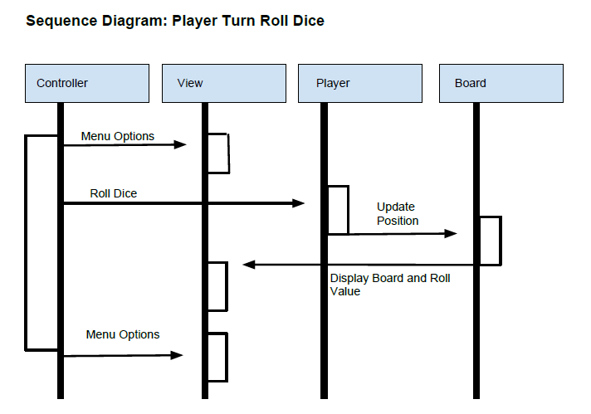

Slide 11
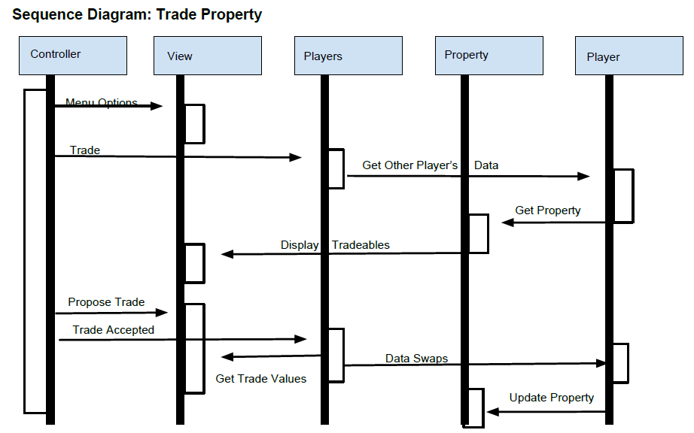

Slide 12
Demo
Video goes here

Slide 13
Questions?

